Slide 1
Skin Cancer Detector
- Bit_Karma

Slide 2
BIT_KARMA
Team Members Name:
Jaya Gupta
Nancy Mangla
Sarwar Ali
Abhishek Goel

Slide 3
Problem Statement
Skin cancer is a dangerous and widespread disease. Each year there are approximately 5.4 million new cases of skin cancer are recorded in USA alone. The mortality rate of this disease is expected to rise in the next decade. The survival rate is less than 14% if diagnosed in later stages. However, if the skin cancer is detected at early stages then the survival rate is nearly 97% . This demands the early detection of skin cancer.

Slide 4
Scope and Goal
Scope :-
Assist physicians classifying Skin Cancer
Goal :-
Use state-of-the art techniques called Deep Learning, to design an intelligent medical imaging-based skin cancer detection system.
Achieve for improve upon deep learning results for
>> skin images segmentation and
>> skin images classification
Evaluate the impact of skin image segmentation on the accuracy of the classifier.

Slide 5
Image Gallery

Slide 6
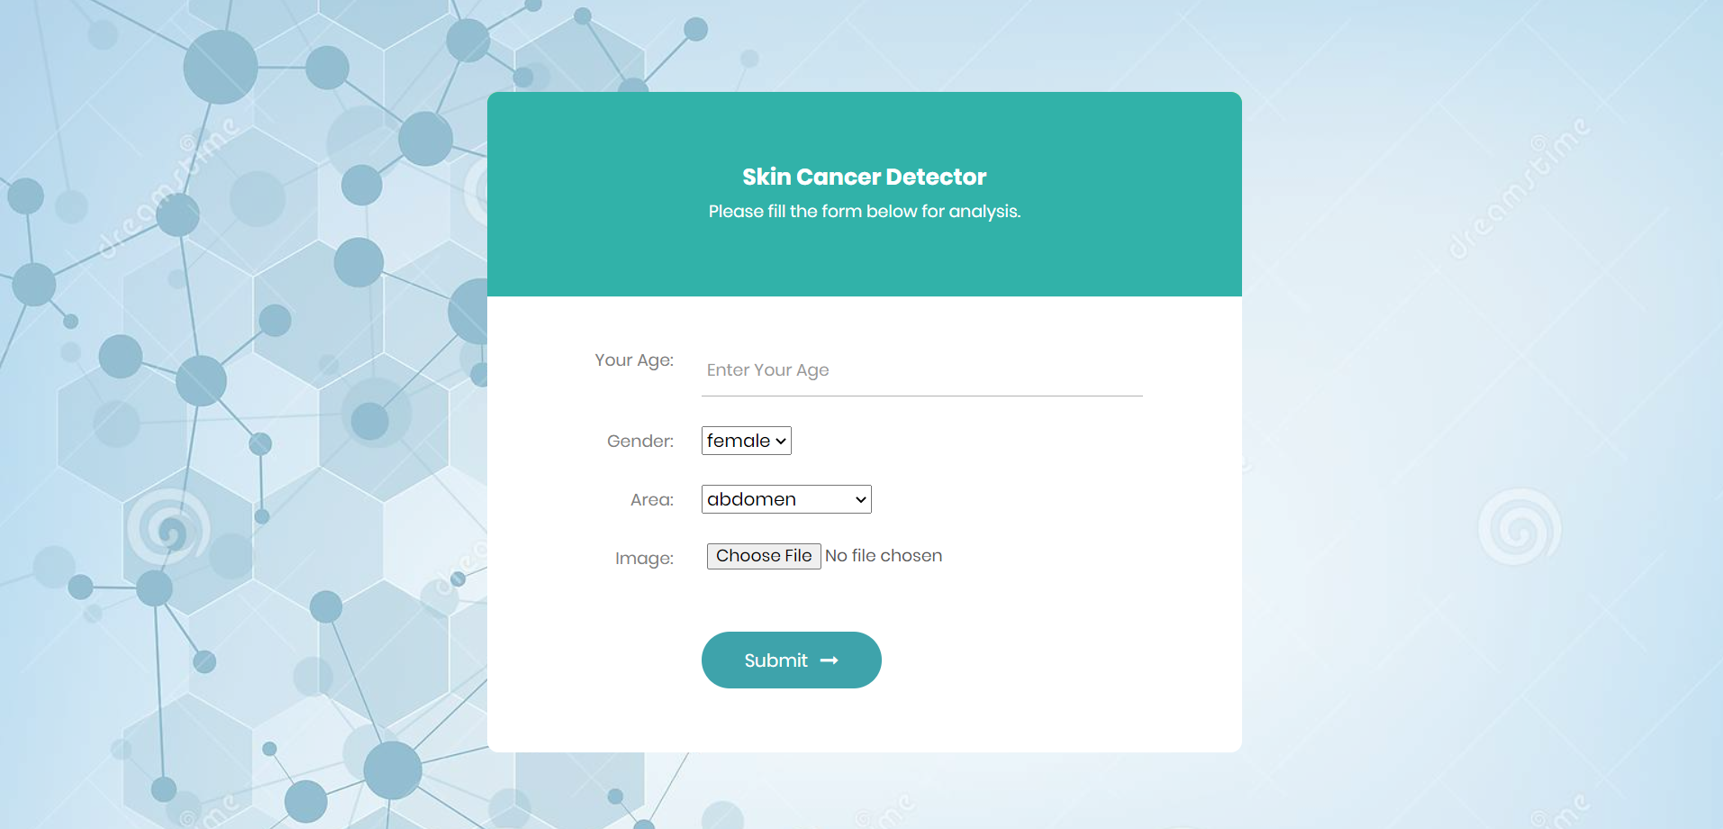
1. User needs to enter respective information

Slide 7
1. User needs to enter respective information

Slide 8
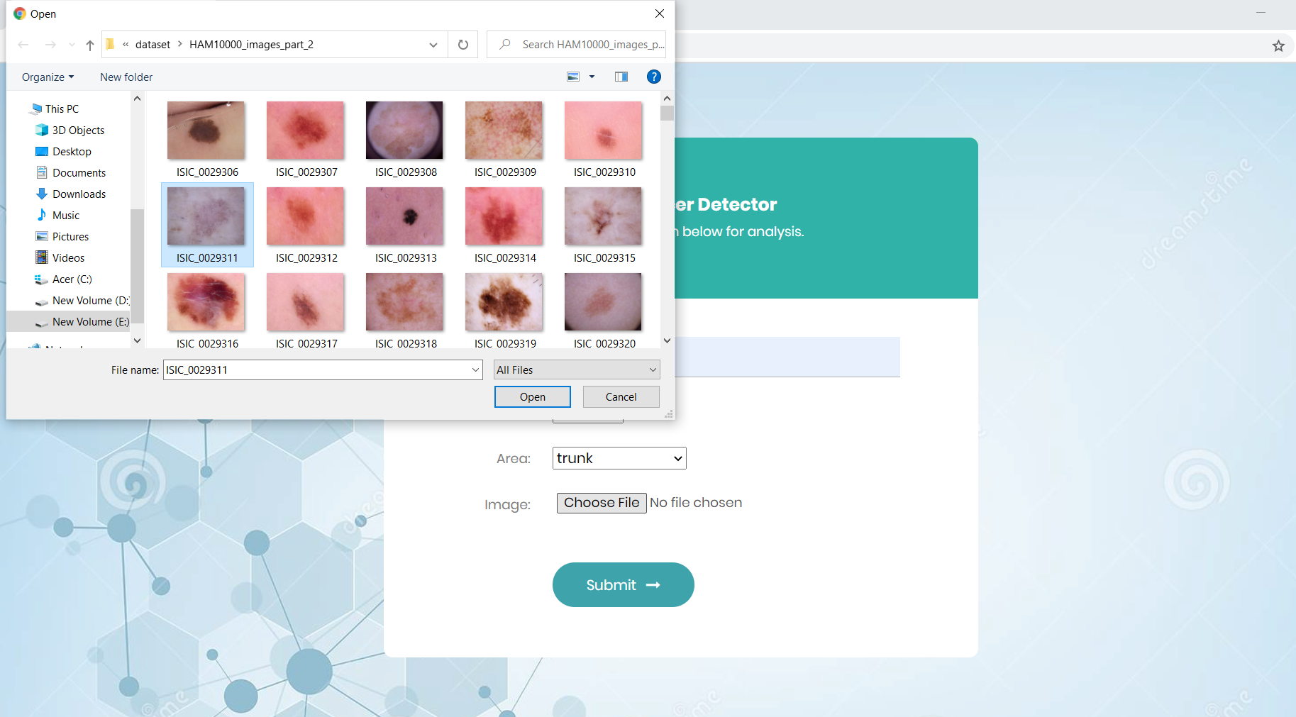
2. User uploading image

Slide 9
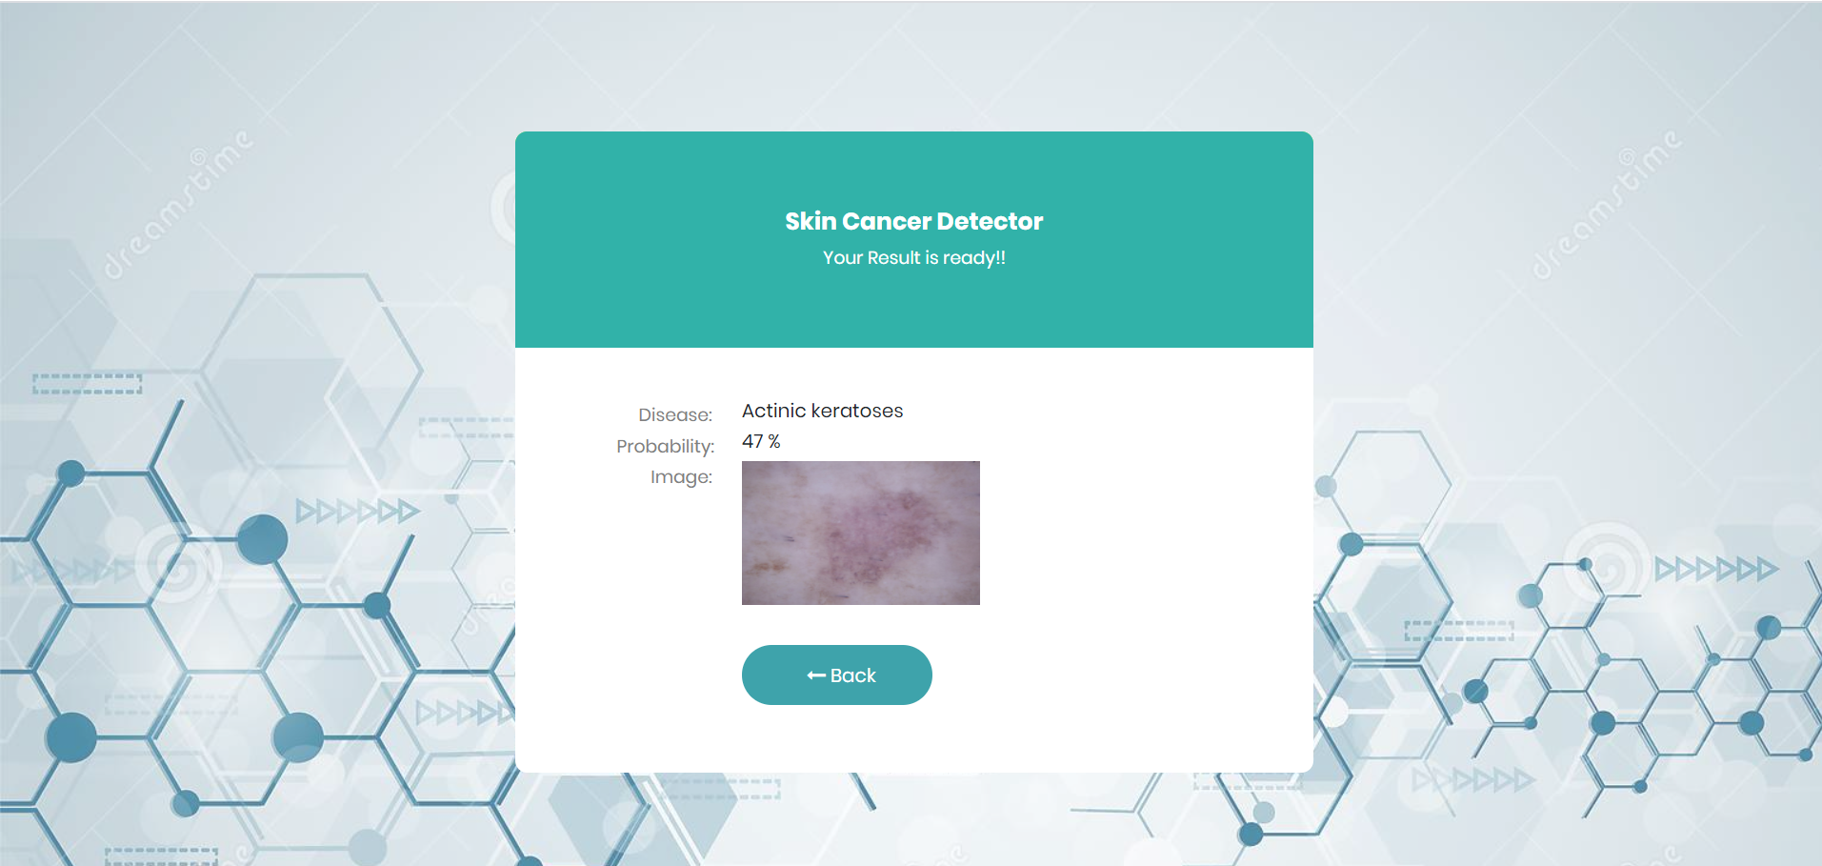
3. Prediction based on entered information

Slide 10
Proposed Tech Stack
Python environment :
>> Keras –Deep Learning library for Tensorflow or Theano
>> OpenCV /PIL (Python Image Library)
>>Scipy (Library for Mathematics, Science and Engineering)
>>Scikit-learn(Machine Learning Library
Frontend :
HTML, CSS, JS
Backend :
Django
Dataset :
From kaggle

Slide 11
Thank You

